Slide 1
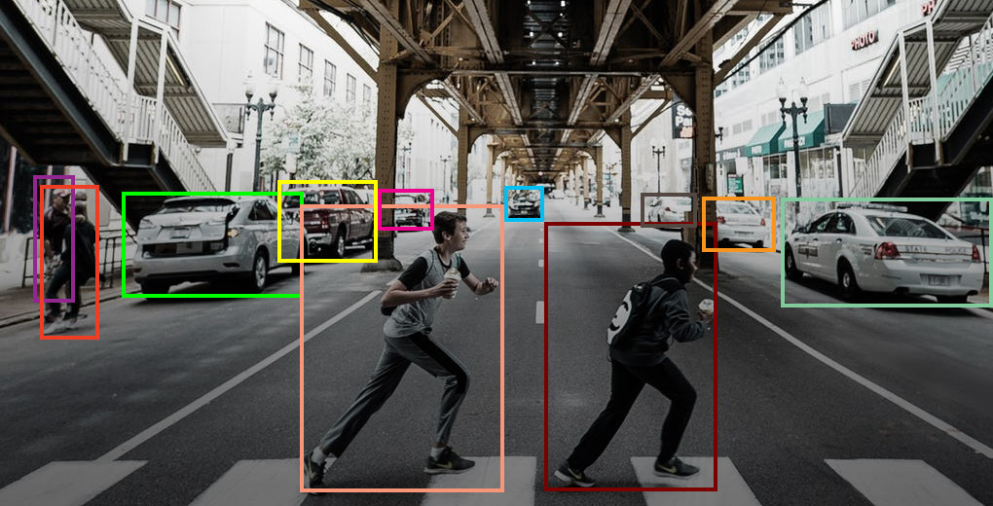

Object tracking
Name: Priyanshu Bhatt
Section: I
Roll no: 76

Slide 2

What Is Object tracking?
Object tracking is a computer vision technique for locating objects in images or videos or simply tracking an object in a live video

Slide 3

object tracking algorithms
MeanShift
CamShift
Optical Flow
Background Subtraction
Deep learning-based methods

Slide 4
MeanShift Algorithm
MeanShift is an iterative algorithm for locating the mode of a probability density function.
It is often used for object tracking.
MeanShift calculates the weighted mean of the current region and shifts it to the new position with maximum probability.

Slide 5
CamShift Algorithm
CamShift (Continuously Adaptive MeanShift) is an extension of the MeanShift algorithm.
It adds the capability to handle the object's orientation and scale changes.
CamShift adjusts the size and orientation of the tracking window iteratively.

Slide 6
Optical Flow
Optical flow is the pattern of apparent motion of objects between consecutive frames.
It can be used for object tracking by estimating the motion vectors of pixels between frames.
OpenCV provides various optical flow algorithms, such as Lucas-Kanade and Farneback.

Slide 7
Background Subtraction
Background subtraction is a common technique for detecting moving objects.
It subtracts the current frame from the background model to obtain a foreground mask.
OpenCV offers different background subtraction algorithms, including MOG (Mixture of Gaussians) and MOG2.

Slide 8
Deep Learning-based Methods
Deep learning has revolutionized computer vision, including object tracking.
OpenCV integrates deep learning frameworks like TensorFlow and PyTorch for object tracking.
Pretrained deep learning models such as YOLO (You Only Look Once) and SSD (Single Shot MultiBox Detector) are commonly used.

Slide 9
Object Tracking Workflow
The general workflow for object tracking using OpenCV:
Initialize the tracker with the initial bounding box or region of interest (ROI).
Process subsequent frames and update the tracker's position.
Repeat step 2 until the object is tracked or lost.

Slide 10

CONCLUSION
OpenCV provides a wide range of object tracking algorithms suitable for different scenarios.
By combining these algorithms with other computer vision techniques, accurate object tracking can be achieved
The above project is a running object tracking system which tracks the vehicle on the road and provides its corresponding ids by using background subtraction technique

Slide 11
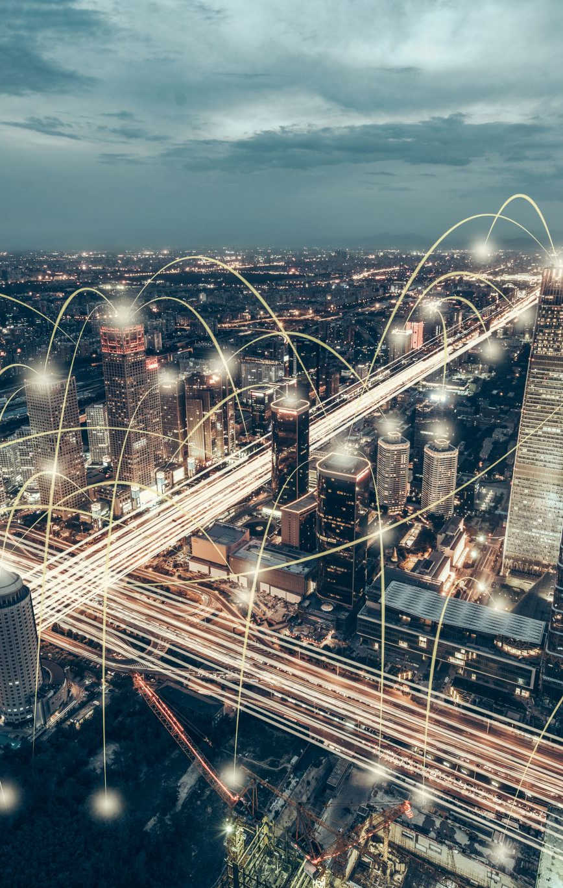
FUTURE SCOPE
The detection of objects enables intelligent healthcare monitoring, autonomous driving, smart video surveillance, anomaly detection, robot vision, animal monitoring and much more.

